Slide 1


<Name>
<Date>

Slide 2

Outline
Executive Summary
Introduction
Methodology
Results
Conclusion
Appendix

Slide 3
Executive Summary
Data collection - from the SapceX API
Data wrangling – processing the data and transforming it to usable form
Data analysis – EDA for gaining information from the data
Visualizations – viewing data in informative ways both static and interactive ways
Modelling – performing predictive analytics on the data to predict landing succession
Final result – the best model for predicting is tree model

Slide 4
Introduction
We have data from SpaceX that conducted numerous experiments
The data include site of launch, payload mass, and more details about the launch
Finally, we have a label whether the experiment was successful or not
Our goal is to predict, given launch parameters whether it will be successful or not

Slide 5

Section 1

Slide 6
Methodology
Executive Summary
Data collection methodology:
The data was collected from spaceX API as a json file
Perform data wrangling
Perform cleaning and scraping, to a csv format
Perform exploratory data analysis (EDA) using visualization and SQL
Perform interactive visual analytics using Folium and Plotly Dash
Perform predictive analysis using classification models
Build various classification models and optimize them by using grid serch
Choose the best scoring model

Slide 7
Data Collection
We used the Space X API to get a json format file
We then extracted from the json the relevant data from our analysis and model to a csv file
Extracting payload data
Extracting launch site
Extracting core data
Calling spaceX API
Getting Json file
Extracting relevant information from json
Inserting to dataframe format
Saving as csv file for further analysis

Slide 8
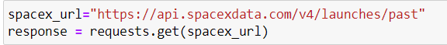
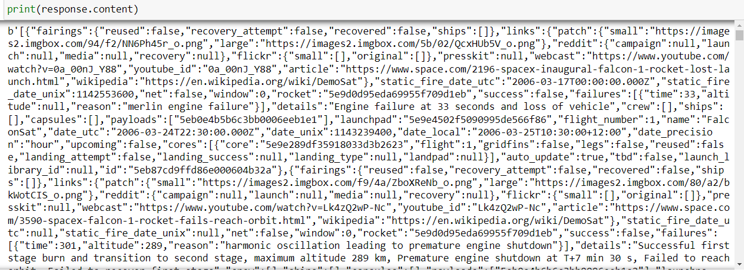
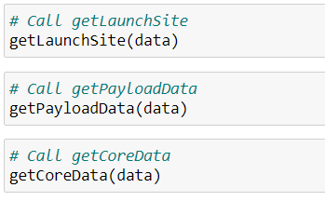
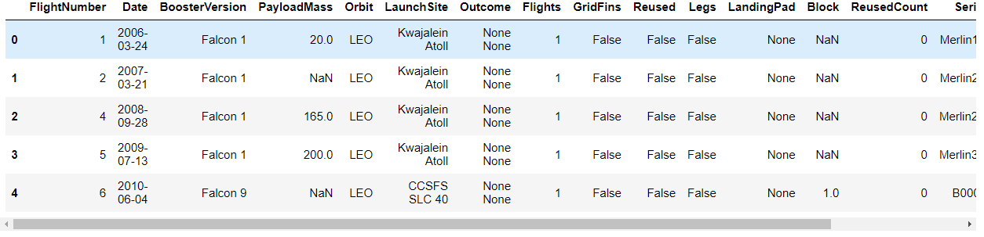
Data Collection – SpaceX API
Flow diagram
GitHub URL :

Slide 9
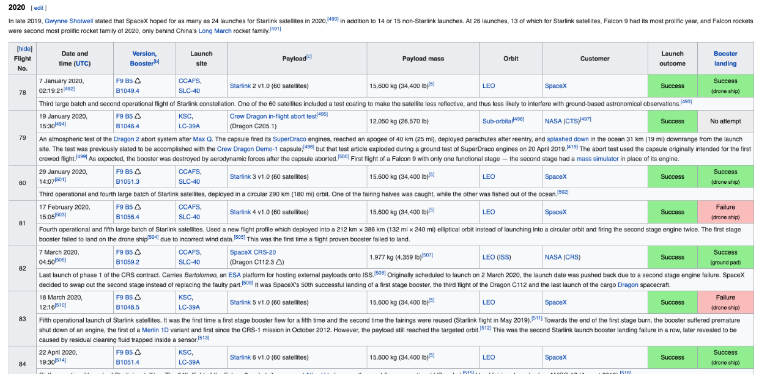
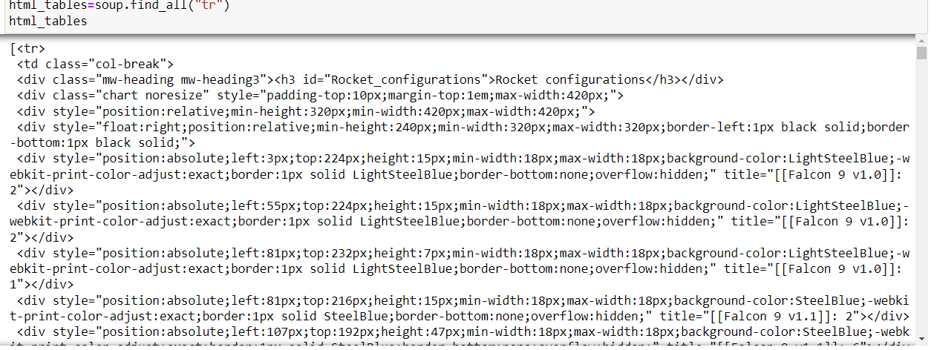
Data Collection - Scraping
Extraction from Wikipedia the external data for each launch – using beautifulsoup
Add the GitHub URL of the completed web scraping notebook, as an external reference and peer-review purpose

Slide 10
Data Wrangling
We using Pandas dataframe as the main structure for our data
We filled missing data with the mean of the column Payload mass
We used the column outcome to build a label column (success or failure)
GitHub URL:

Slide 11
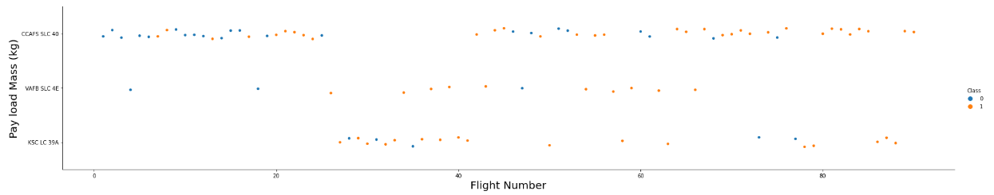
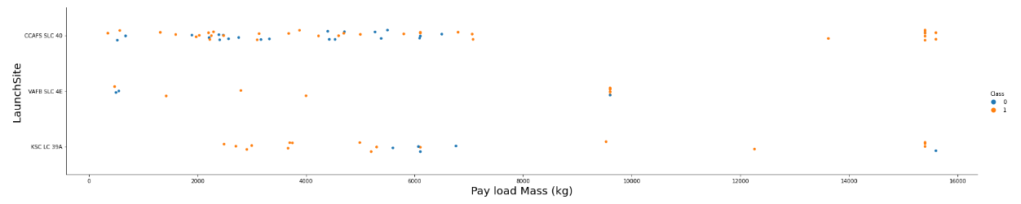
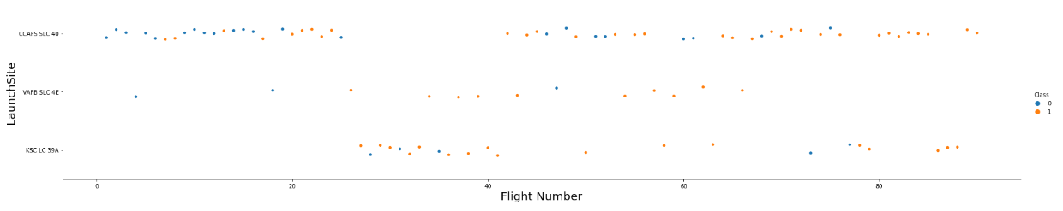
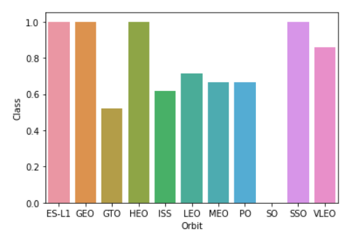
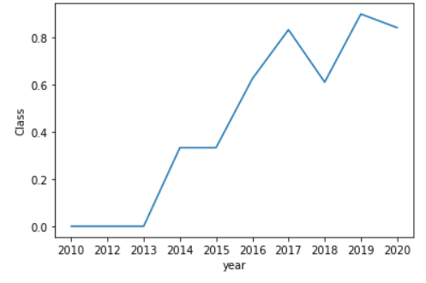
EDA with Data Visualization
We plotted flight number and payload mass and launch site against each other to see if there is some correlation
We wanted to see what orbit has the most successful launches
We checked what year yielded the most successful luanches
Github URL :

Slide 12
EDA with SQL
We checked a few queries using SQL for example:
the total payload mass carried by boosters launched by NASA (CRS) : 45596
average payload mass carried by booster version F9 v1.1 : 2534.66
the date when the first succesful landing outcome in ground pad was achieved : 2015-12-22
the total number of successful and failure mission outcomes : Success-100, Failure-1
Add the GitHub URL:

Slide 13
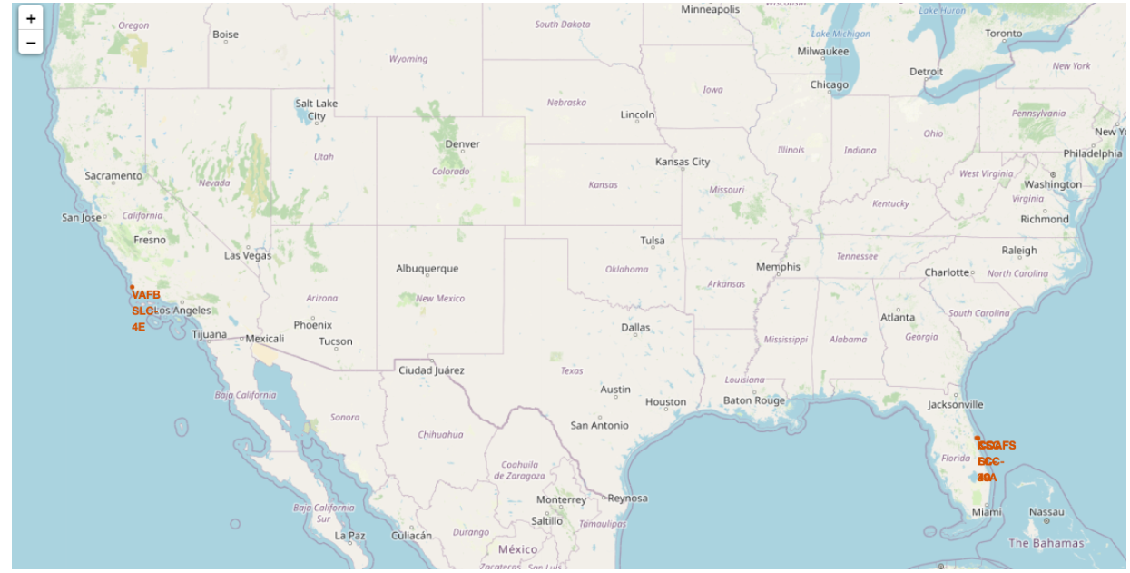
Build an Interactive Map with Folium
We build and mapped a geographic map with all launch sites
Each launch site is markered by a red circle
Add the GitHub URL of your completed interactive map with Folium map, as an external reference and peer-review purpose

Slide 14
Build a Dashboard with Plotly Dash
Summarize what plots/graphs and interactions you have added to a dashboard
Explain why you added those plots and interactions
Add the GitHub URL of your completed Plotly Dash lab, as an external reference and peer-review purpose

Slide 15
Predictive Analysis (Classification)
We used 4 classification models to predict the succession of each observation (i.e each experiment)
After each model building we optimized it using grid search with 10 folds
For each model we selected the best version of it and compared all models with each other
Add the GitHub URL of your completed predictive analysis lab, as an external reference and peer-review purpose

Slide 16
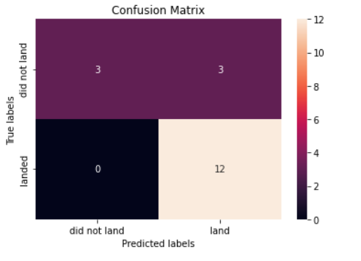
Results
The best model was decision tree with training score of:0.875
And testing score of:0.833
The confusion matrix of this model has TP of 12 and TN of 3

Slide 17


